Slide 1

Using “Machine Learning” (a.k.a statistics) to estimate the unknown

Slide 2
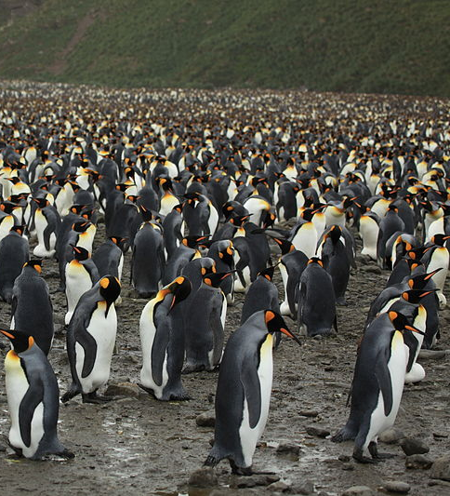
Where we are
All of this is to figure out what the population size is
Fundamental for conserving/managing a species
To do this we need to estimate two parameters
The capture rate (p)
The number never encountered (f₀)
Previously we just assumed the values of these
But in reality MLE does this
We will inevitably run different versions of these models
How do we choose which hypothesis best matches the observations?
Is it M_{o}, M_{t}, M_{b}, etc.?

Slide 3
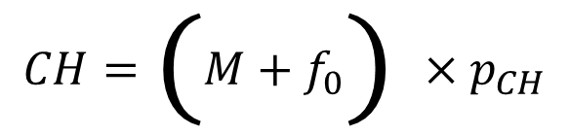
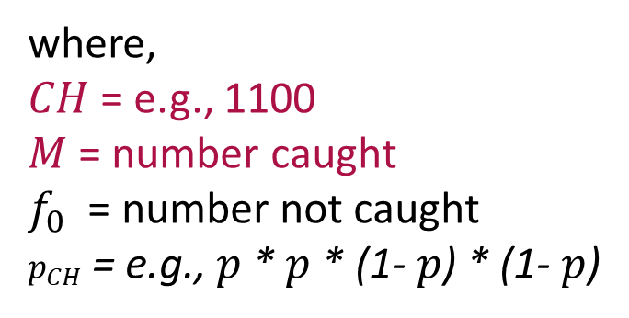
Closed CMR; statistics and data
$$y = mx + c$$
$$CH=\left(M+f_{0}\right)×p_{CH}$$
where,
$CH$ = e.g., 1100
$M$ = number caught
$f_{0}$ = number not caught
$p_{CH}$ = e.g., $p$ * $p$ * (1- $p$) * (1- $p$)
Note that this is a huge simplification!
Observed
Data
Unobserved
“Parameter”

Slide 4
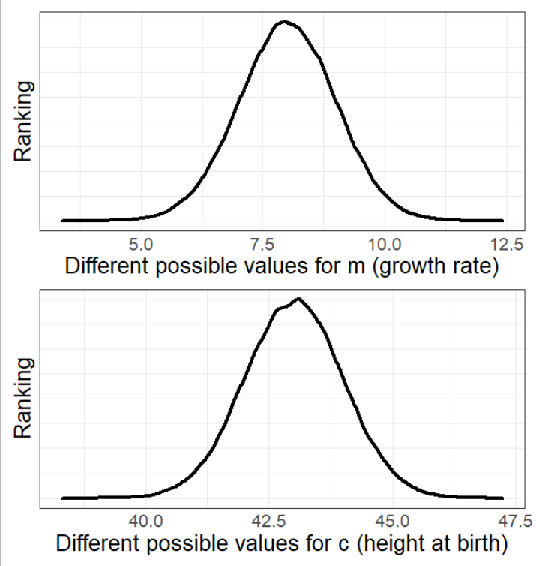
How does Maximum Likelihood Estimate work?
Previously I said;
‘The “algorithm” tries many different possible values for all parameters.’
But that’s not very satisfying.
What follows is very complex.
I do not expect you to understand, I just want to give you an idea of how the engine works.

Slide 5
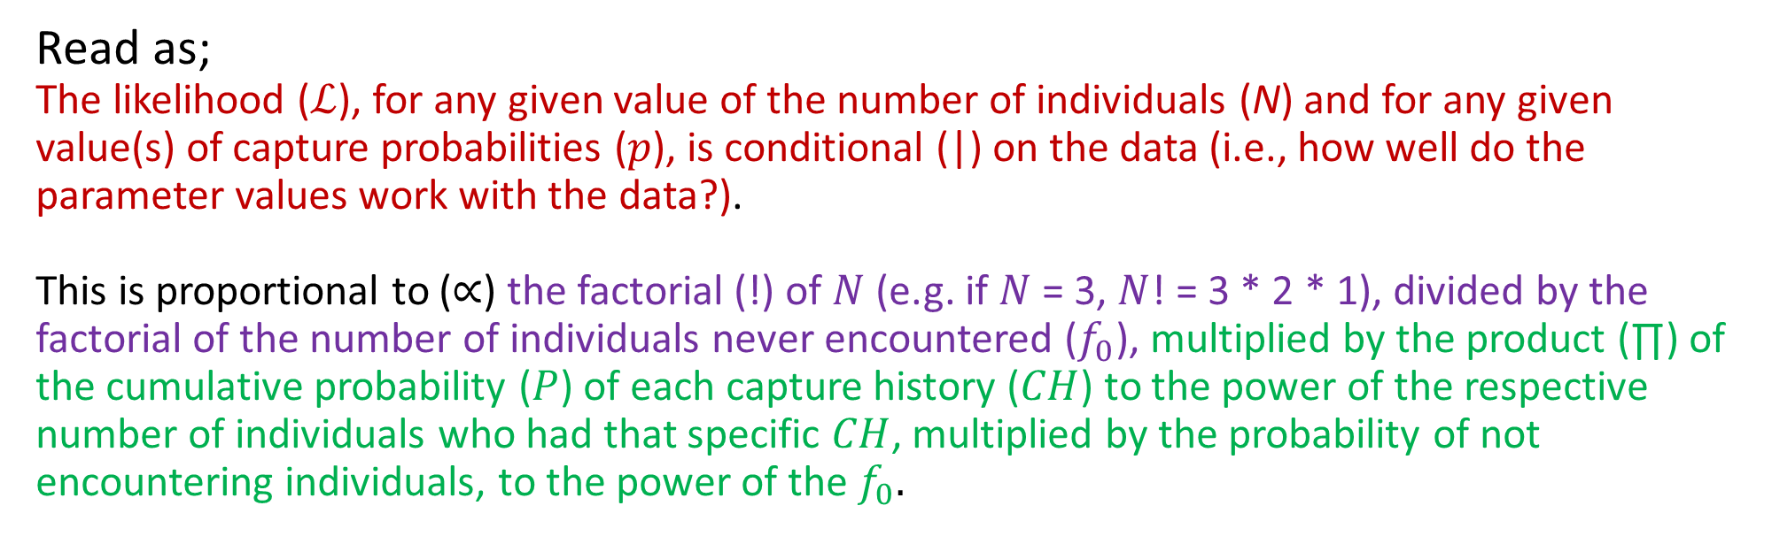
Behind the scenes
The “rating” (a.k.a. the Likelihood) equation
$$ℒ\left(N,p | data\right)∝\frac{N!}{f_{0}!}\prod_{CH}{P{\left[CH\right]}^{n_{CH}}}∗P{\left[not encountered\right]}^{f_{0}}$$
Read as;
The likelihood ($ℒ$), for any given value of the number of individuals (N) and for any given value(s) of capture probabilities ($p$), is conditional (|) on the data (i.e., how well do the parameter values work with the data?).
This is proportional to ($∝$) the factorial (!) of $N$ (e.g. if $N$ = 3, $N$! = 3 * 2 * 1), divided by the factorial of the number of individuals never encountered ($f_{0}$), multiplied by the product (∏) of the cumulative probability ($P$) of each capture history ($CH$) to the power of the respective number of individuals who had that specific $CH$, multiplied by the probability of not encountering individuals, to the power of the $f_{0}.$

Slide 6
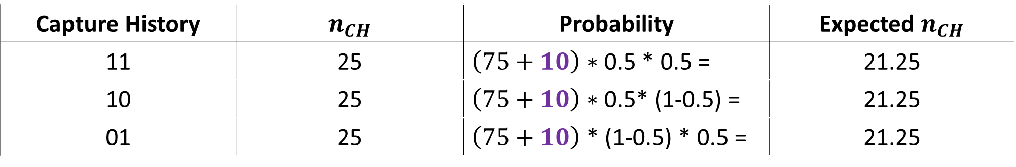
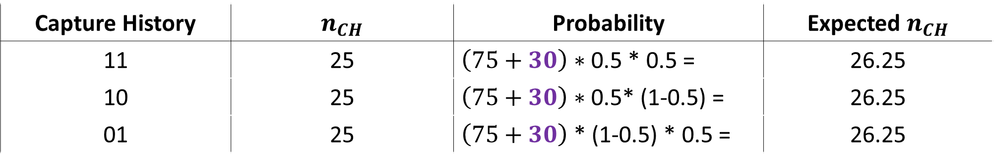
Let’s calculate MLE
Let’s try assuming $f_{0}$ is 10 (i.e. we failed to encounter 10 animals)
Capture History | $n_{CH}$ | Probability | Expected $n_{CH}$
11 | 25 | $\left(75+10\right)∗$ 0.5 * 0.5 = | 21.25
10 | 25 | $\left(75+10\right)∗$ 0.5* (1-0.5) = | 21.25
01 | 25 | $\left(75+10\right)$ * (1-0.5) * 0.5 = | 21.25
How about assuming $f_{0}$ is 30
Capture History | $n_{CH}$ | Probability | Expected $n_{CH}$
11 | 25 | $\left(75+30\right)∗$ 0.5 * 0.5 = | 26.25
10 | 25 | $\left(75+30\right)∗$ 0.5* (1-0.5) = | 26.25
01 | 25 | $\left(75+30\right)$ * (1-0.5) * 0.5 = | 26.25

Slide 7

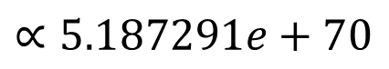
When $f_{0}$ = 10 and $p$ = 0.5
$$ℒ\left(N,p | data\right)∝\frac{N!}{f_{0}!}\prod_{CH}{P{\left[CH\right]}^{n_{CH}}}∗P{\left[not encountered\right]}^{f_{0}}$$
$$∝\frac{85!}{10!}\prod_{CH}{(0.25{\left[{CH}_{11}\right]}^{25}}∗ 0.25{\left[{CH}_{10}\right]}^{25} ∗ 0.25{\left[{CH}_{01}\right]}^{25}) ∗0.25{\left[{CH}_{00}\right]}^{10}$$
$$∝7.763184e+121 ∗6.681912e−52$$
$$∝5.187291e+70$$
$$∝51,872,910,000,000,002,626,644,064,642,484,628,620,480,602,880,426,460,084,042,624,462,424,266$$

Slide 8
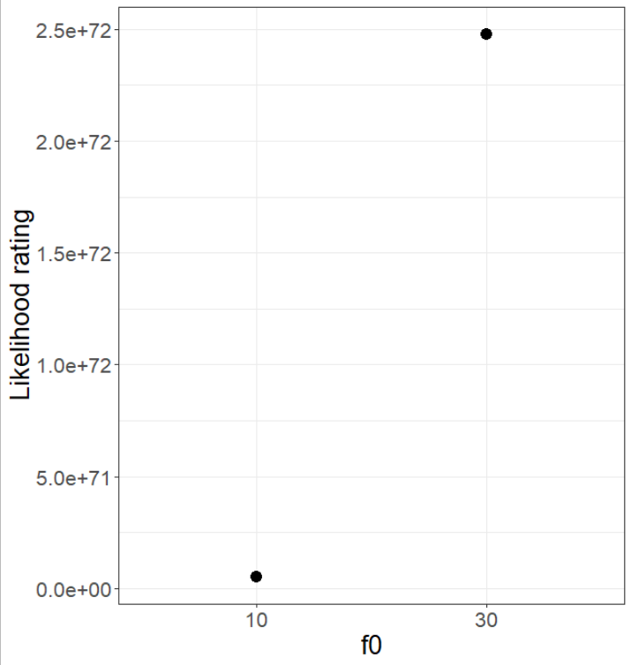
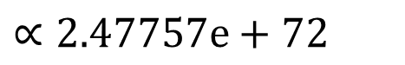

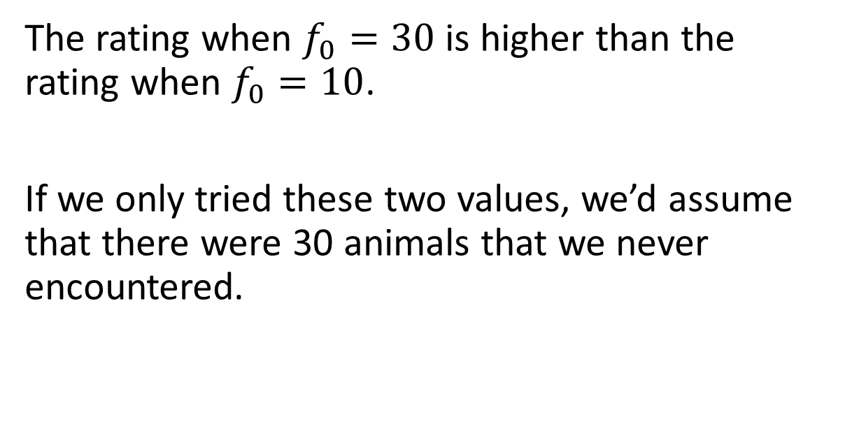
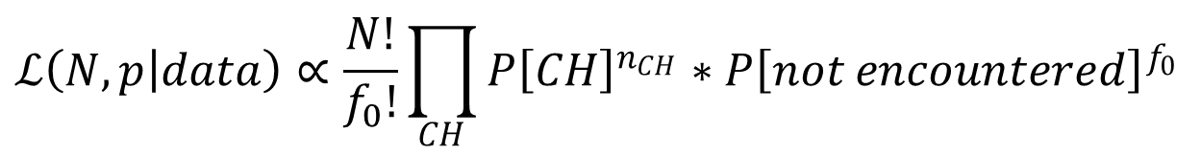
When $f_{0}$ = 30 and $p$ = 0.5
$$ℒ\left(N,p | data\right)∝\frac{N!}{f_{0}!}\prod_{CH}{P{\left[CH\right]}^{n_{CH}}}∗P{\left[not encountered\right]}^{f_{0}}$$
$$∝2.47757e+72$$
The rating when $f_{0}=30$ is higher than the rating when $f_{0}=10$.
If we only tried these two values, we’d assume that there were 30 animals that we never encountered.

Slide 9
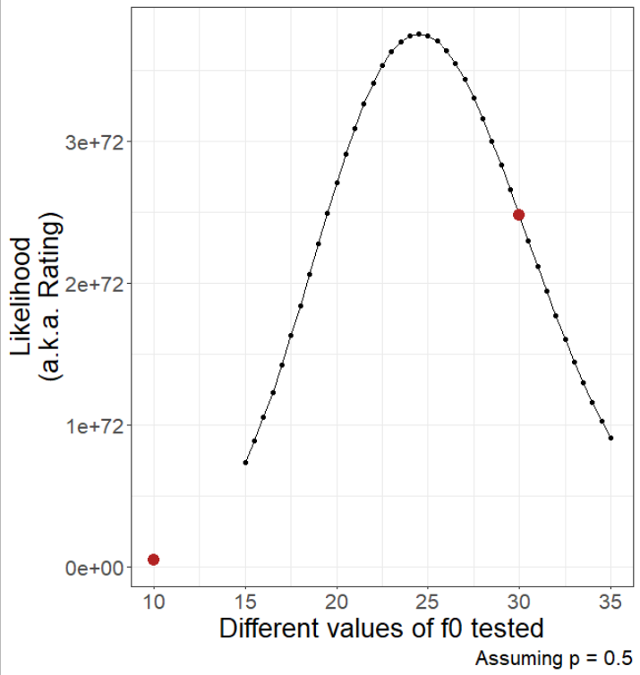
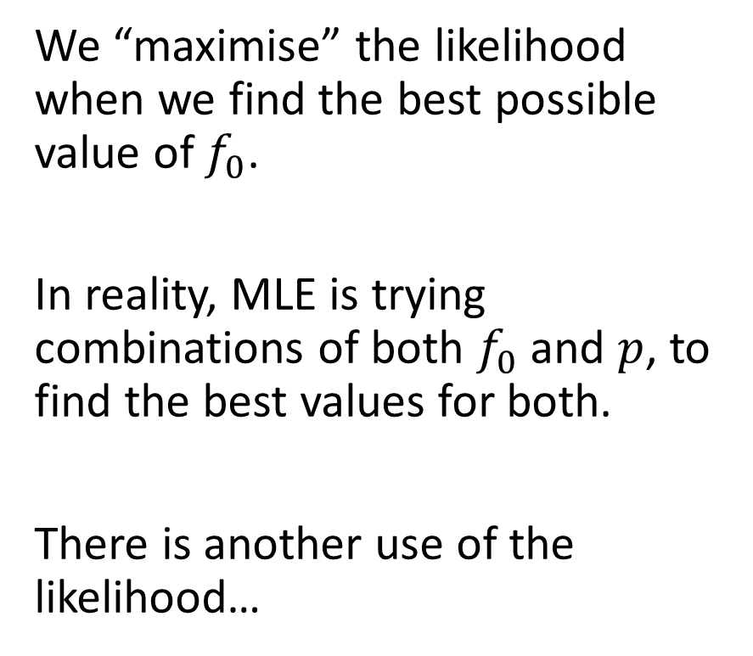
Letting MLE do it’s thing
We “maximise” the likelihood when we find the best possible value of $f_{0}$.
In reality, MLE is trying combinations of both $f_{0}$ and $p$, to find the best values for both.
There is another use of the likelihood…

Slide 10

Which model best fits our data?
When running analysis, you will invariably have multiple models (each of which reflect a different process), all trying to explain the same pattern, e.g.,
M_{o}
M_{t}
M_{b}
Out of all the models (i.e., processes) that we’ve run, how do we choose the most likely model?
AIC
“An Information Criteria” or “Information Criterion A”
“Improperly” called Akaike’s Information Criteria
He never named it after himself
赤池 弘次, Akaike Hirotsugu

Slide 11
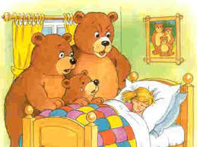
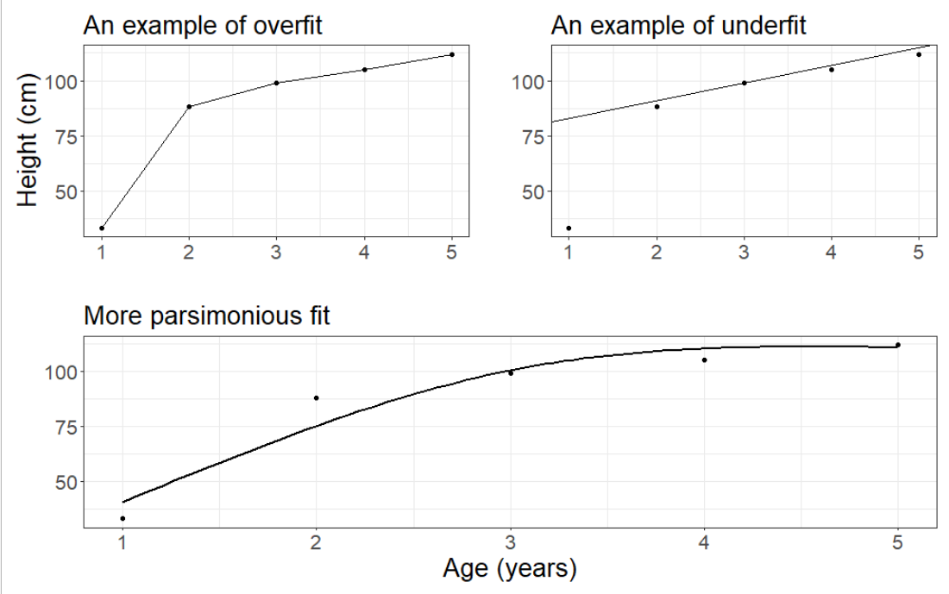
Overfitting and underfitting
Overfit:
Explains data almost “perfectly”
I.e. model fit (line) goes through each observation
But “costs” lots of parameters
E.g. here we’ve used 5 parameters with only 5 observations
Underfit:
Explains poorly
I.e. prediction (line) doesn’t really match the observations
But is very “cheap”
E.g. here we’ve used 2 parameters with only 5 observations

Slide 12
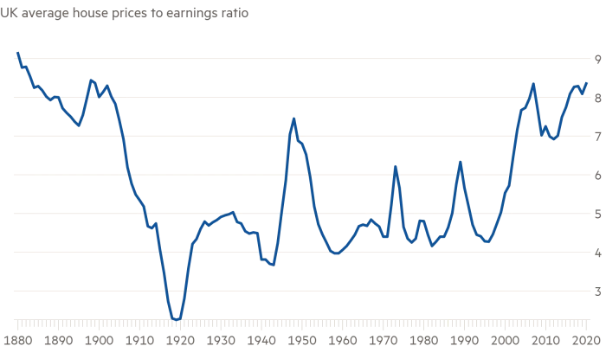
Using AIC to find most the “parsimonious” model
To do so, we use the best Likelihood value (“rating”) for each of the different models that we’ve run.
Though we need to tweak the Likelihood
(and we’ll use this to choose which house we’ll buy)

Slide 13
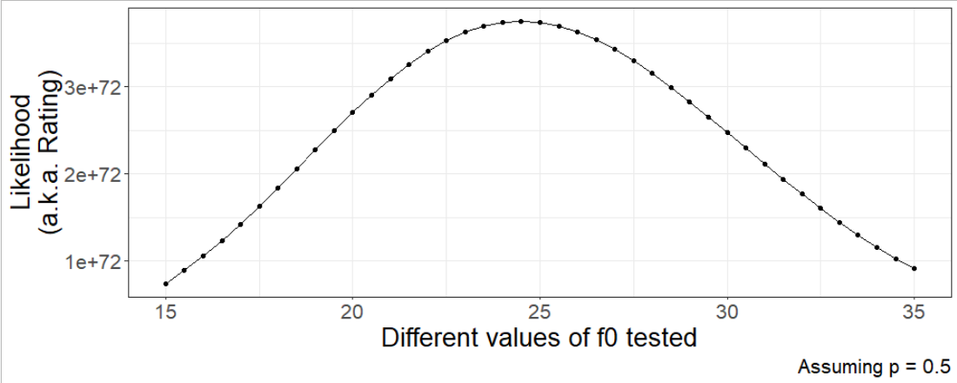
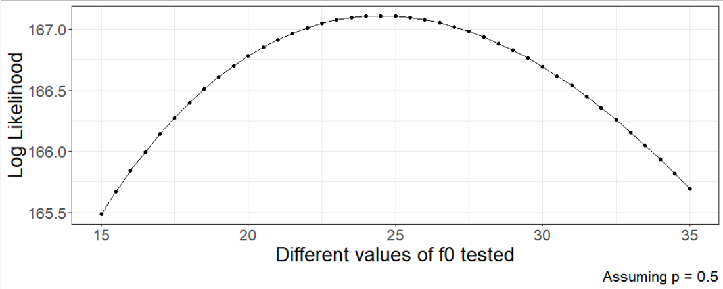
For a single model: Likelihood to Log-Likelihood
First, log transform the likelihood:

Slide 14
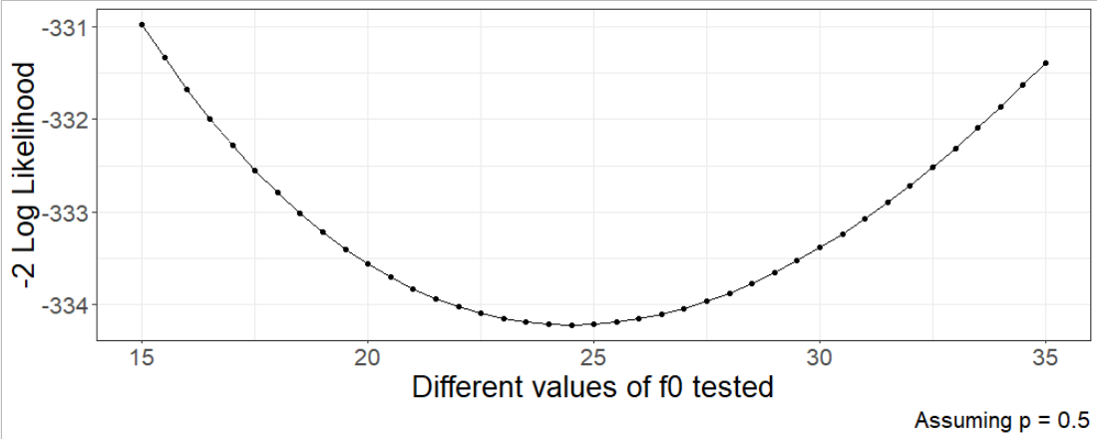
For a single model: Log-Likelihood to -2*Log Likelihood
Then, multiply the log transform by -2:

Slide 15
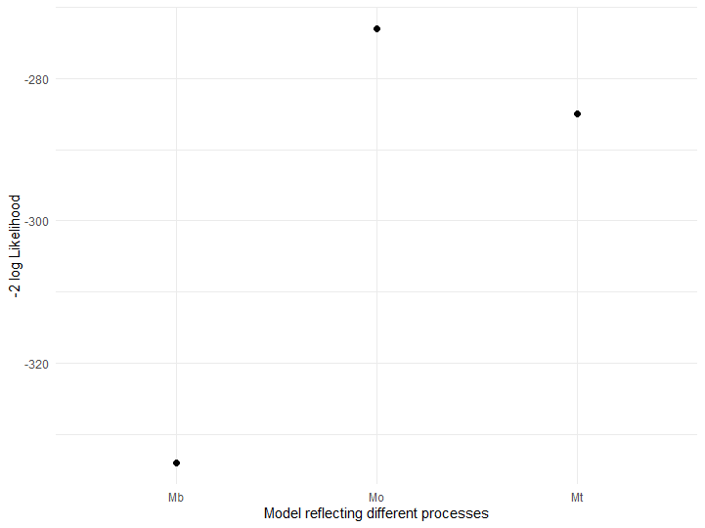
Each model will have a single -2Log Likelihood

Slide 16

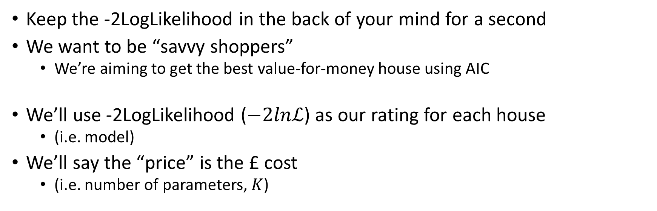
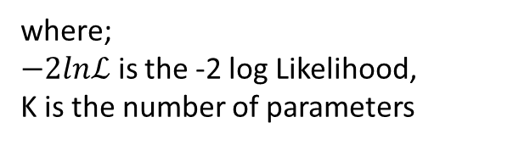
Savvy shoppers
Keep the -2LogLikelihood in the back of your mind for a second
We want to be “savvy shoppers”
We’re aiming to get the best value-for-money house using AIC
We’ll use -2LogLikelihood ($−2lnℒ$) as our rating for each house
(i.e. model)
We’ll say the “price” is the £ cost
(i.e. number of parameters, $K$)
$$AIC=−2lnℒ+2K$$
where;
$−2lnℒ$ is the -2 log Likelihood,
K is the number of parameters

Slide 17
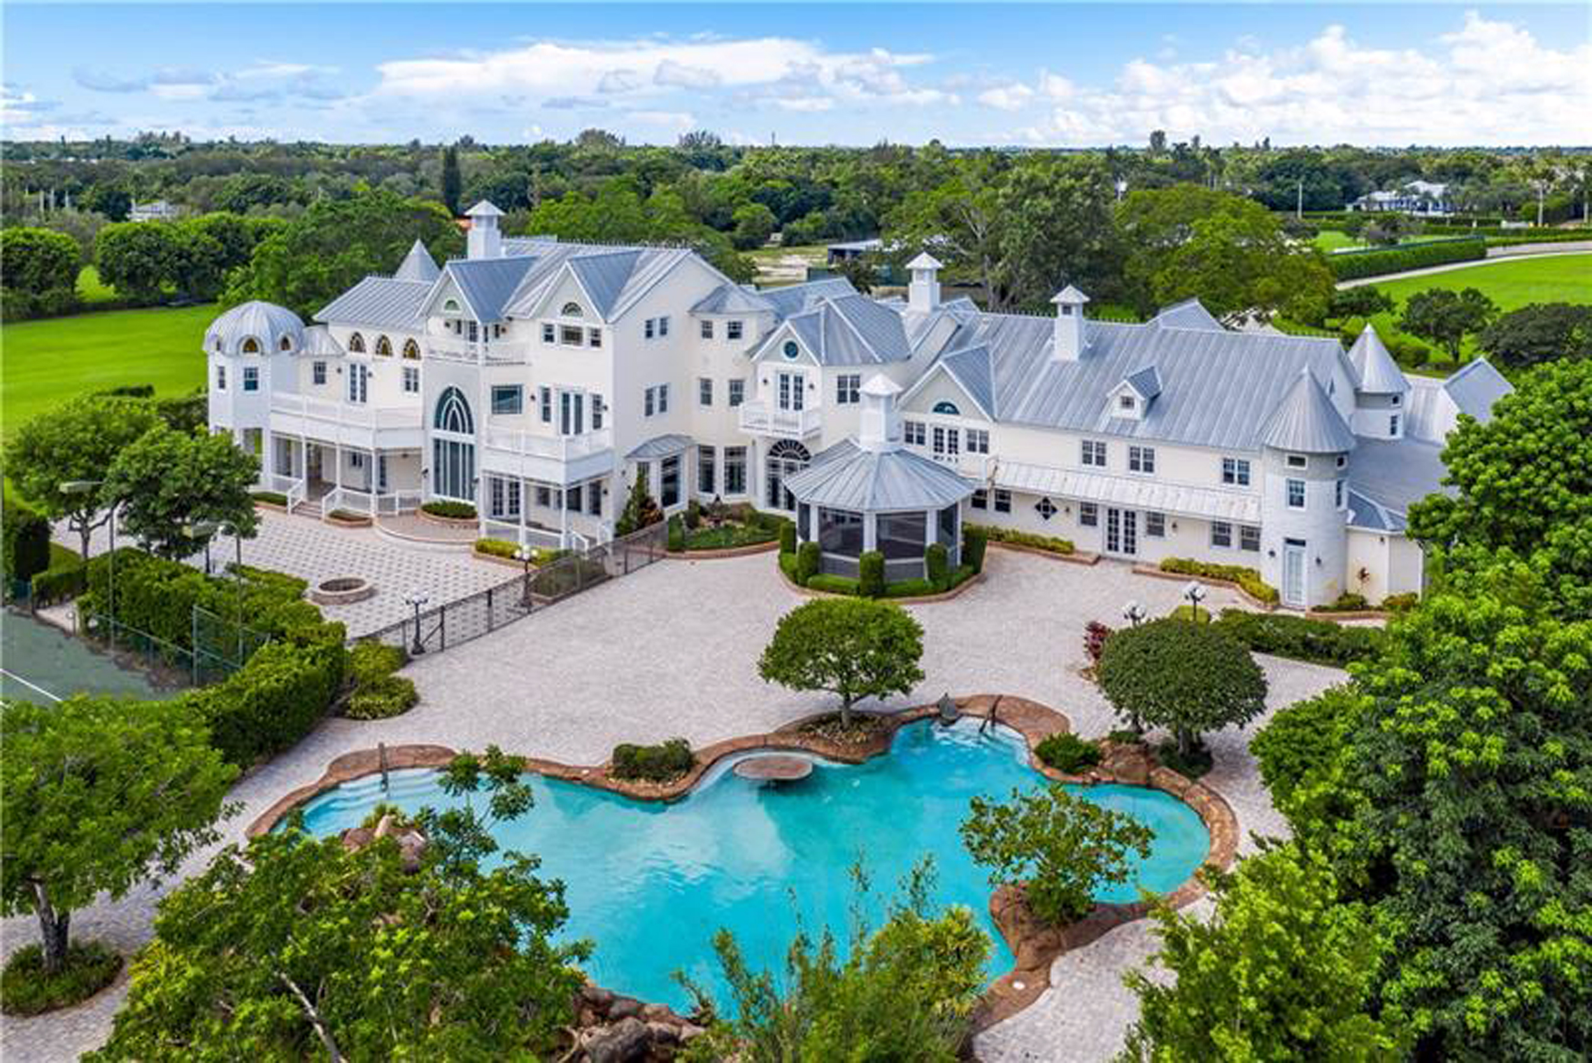
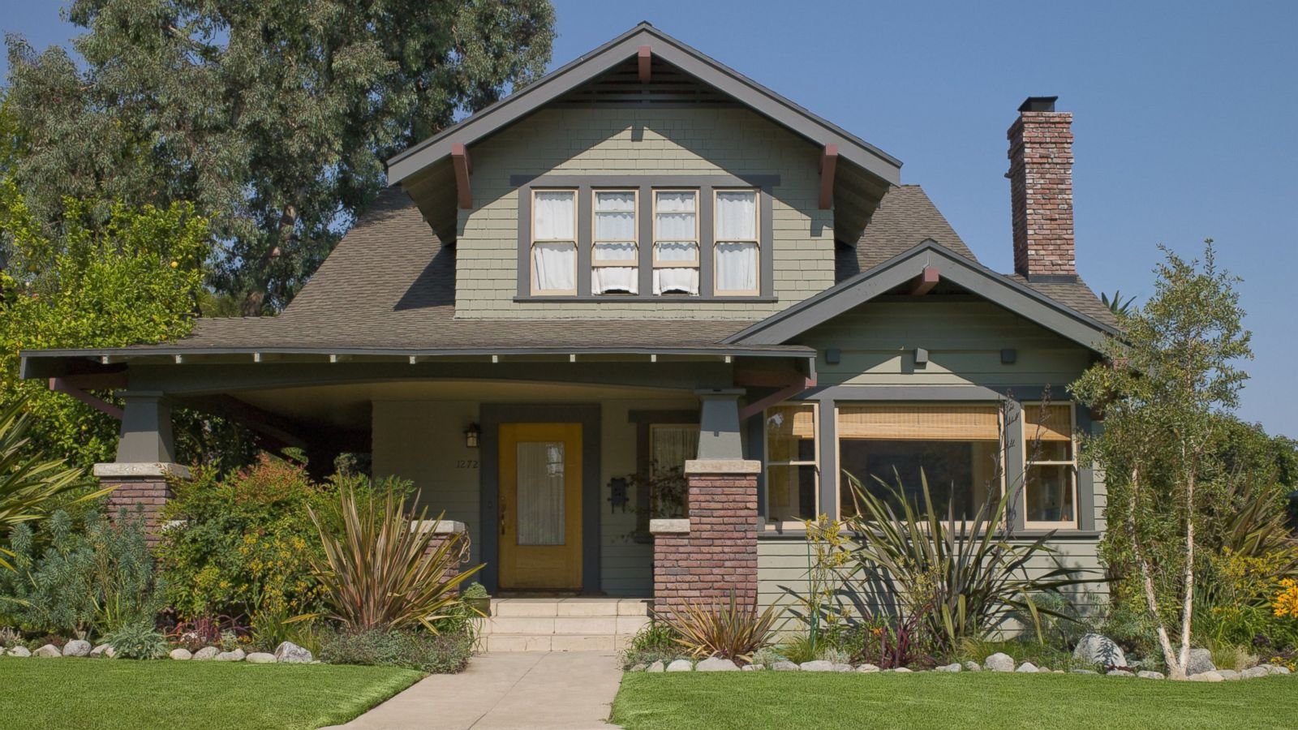
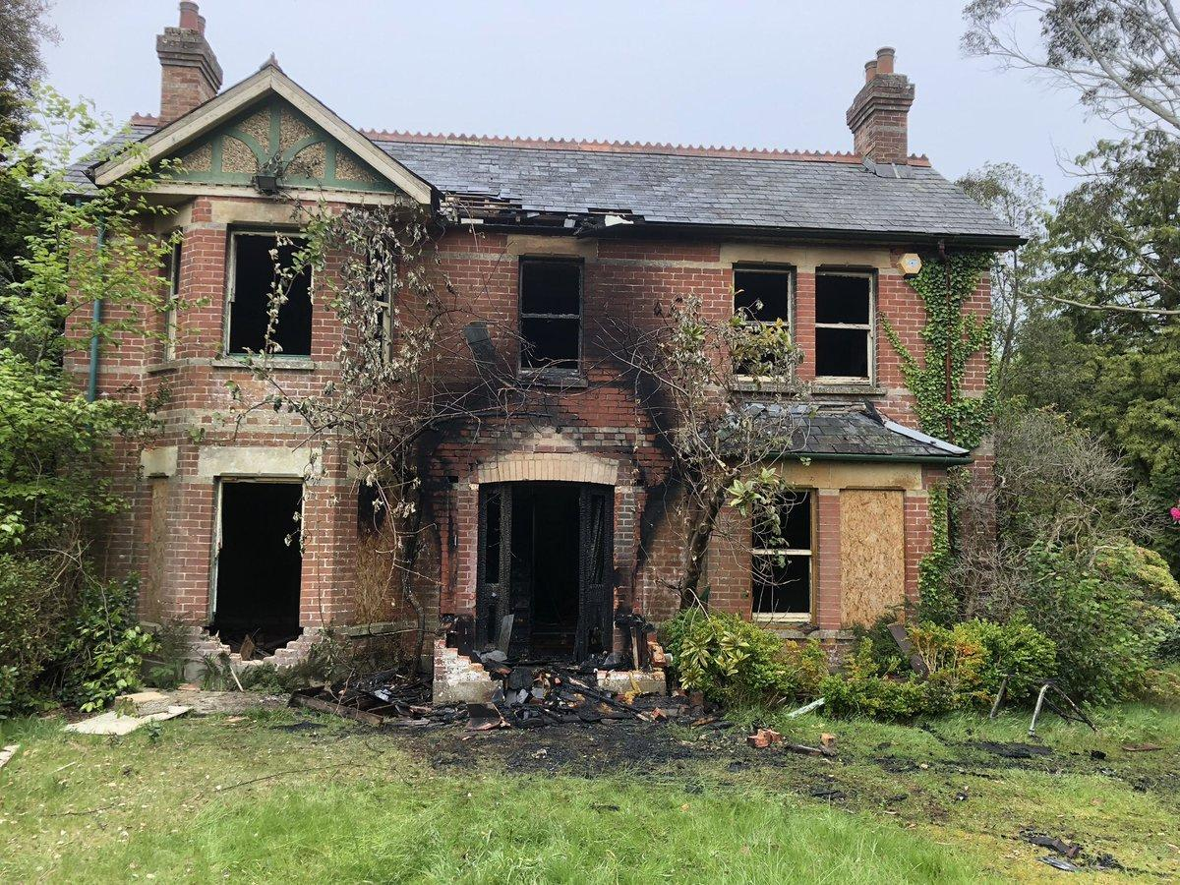
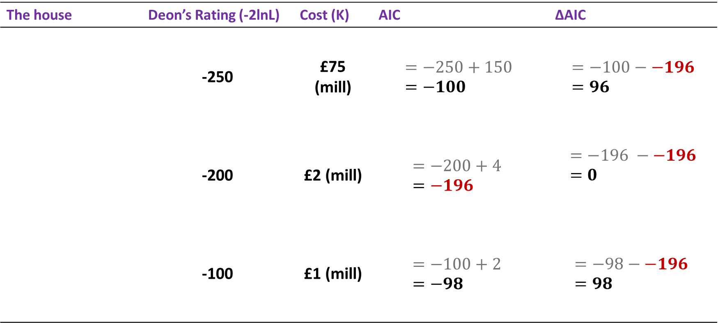

Let’s buy a house
The house | Deon’s Rating (-2lnL) | Cost (K) | AIC | ∆AIC
 | -250 | £75 (mill) | $$=−250+150 =−100$$ | $$=−100−−196=96$$
 | -200 | £2 (mill) | $$=−200+4 \\ =−196$$ | $$=−196 −−196=0$$
 | -100 | £1 (mill) | $$=−100+2 \\ =−98$$ | $$=−98−−196 =98$$
$$AIC=−2lnℒ+2K$$

Slide 18
Model selection with AIC
We always choose the model with the lowest AIC
This will be the model where ∆AIC = 0
Any models with ∆AIC > 2, we reject them
If there are models with ∆AIC < 2, both models are valid.
Of those two models, you choose which one to use
Always run the simplest possible model!!!
What if I didn’t buy a house?
No more p-values!

Slide 19
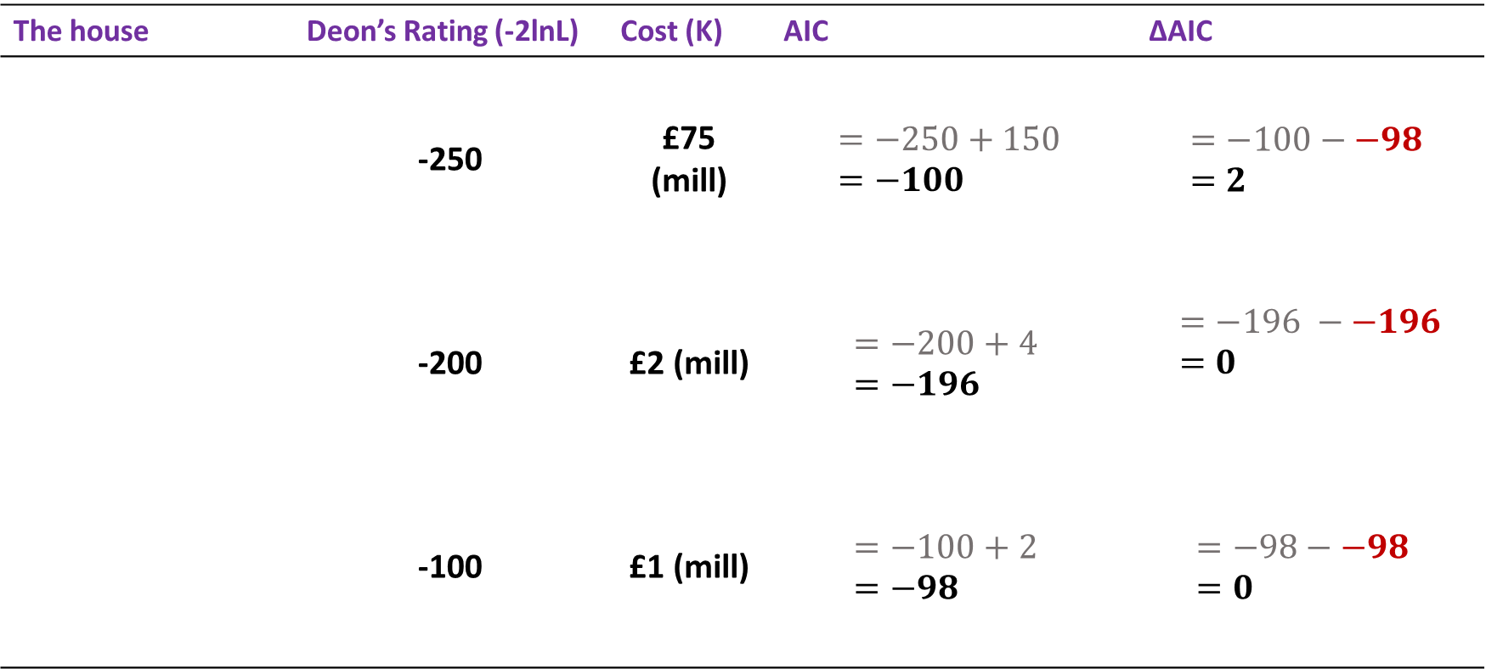
Which house do we choose now?
The house | Deon’s Rating (-2lnL) | Cost (K) | AIC | ∆AIC
 | -250 | £75 (mill) | $$=−250+150 =−100$$ | $$=−100−−98 \\ =2$$
 | -200 | £2 (mill) | $$=−200+4 \\ =−196$$ | $$=−196 −−196=0$$
 | -100 | £1 (mill) | $$=−100+2 \\ =−98$$ | $$=−98−−98 \\ =0$$
$$AIC=−2lnℒ+2K$$

Slide 20
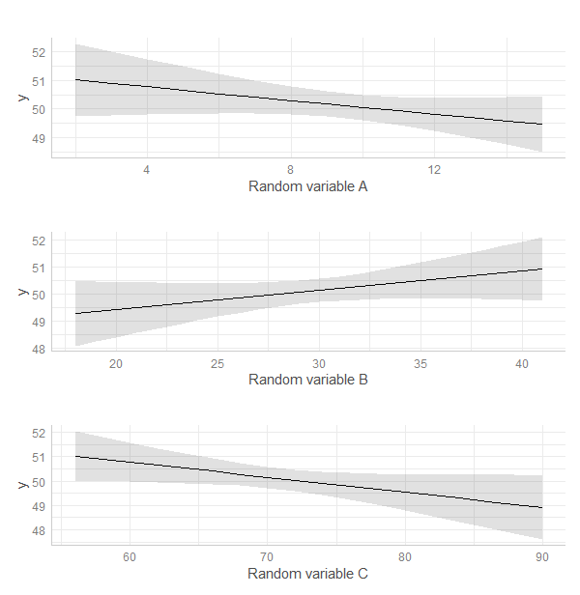
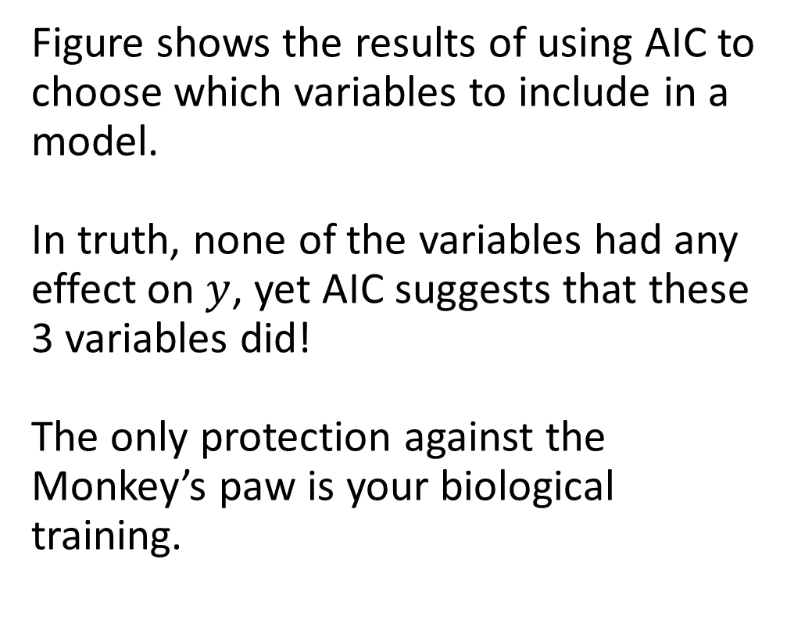
No amount of clever statistics can save you from the Monkey’s paw!
Figure shows the results of using AIC to choose which variables to include in a model.
In truth, none of the variables had any effect on $y$, yet AIC suggests that these 3 variables did!
The only protection against the Monkey’s paw is your biological training.

Slide 21



Real life application of closed CMR
American mink in the Hebrides
Mink “escaped” fur farms in 1960’s
Spread all over Scotland and reached South Uist in 2001
Any captured mink are eradicated

Slide 22
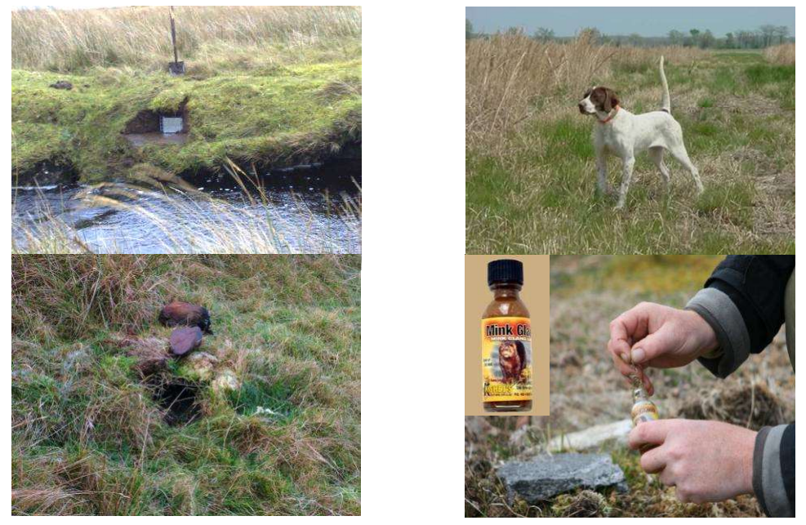
7,500 mink traps operated by 14 staff

Slide 23
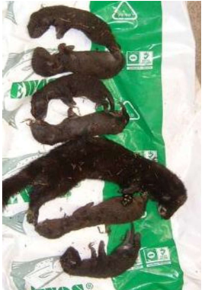
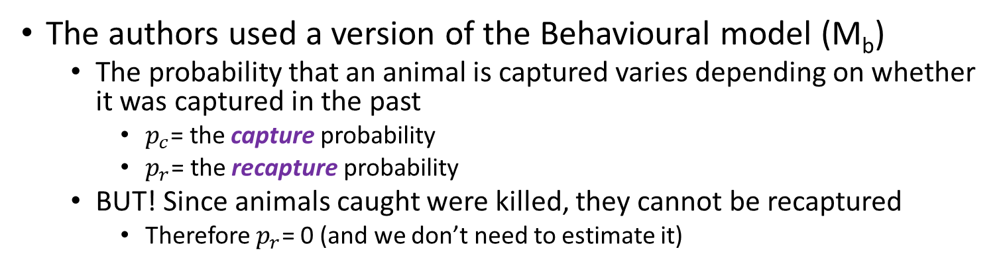

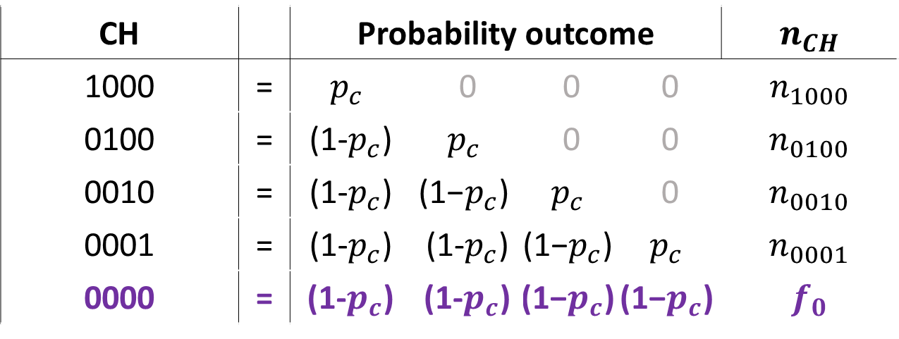
A Closed CMR model to estimate $\hat{N}$
The authors used a version of the Behavioural model (M_{b})
The probability that an animal is captured varies depending on whether it was captured in the past
$p_{c}$= the capture probability
$p_{r}$= the recapture probability
BUT! Since animals caught were killed, they cannot be recaptured
Therefore $p_{r}$= 0 (and we don’t need to estimate it)
CH |  | Probability outcome | Capture prob | Capture prob | Capture prob | $n_{CH}$
1000 | = | $$p_{c}$$ | 0 | 0 | 0 | $n_{1000}$
0100 | = | (1-$p_{c}$) | $$p_{c}$$ | 0 | 0 | $n_{0100}$
0010 | = | (1-$p_{c}$) | $$\text{(1−}p_{c}\text{)}$$ | $$p_{c}$$ | 0 | $n_{0010}$
0001 | = | (1-$p_{c}$) | (1-$p_{c}$) | $$\text{(1−}p_{c}\text{)}$$ | $$p_{c}$$ | $n_{0001}$
0000 | = | (1-$p_{c}$) | (1-$p_{c}$) | $$\text{(1−}p_{c}\text{)}$$ | $$\text{(1−}p_{c}\text{)}$$ | $f_{0}$

Slide 24
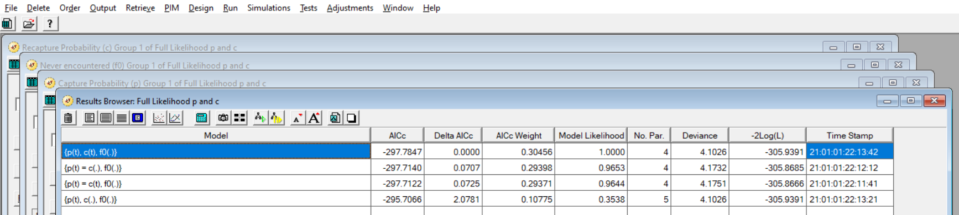
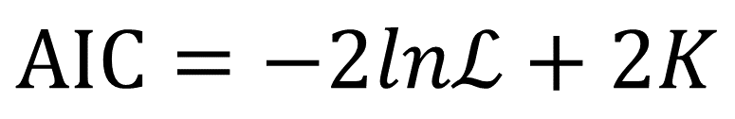
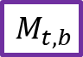
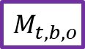
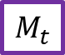
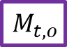
Mink models in MARK
Models sorted by ∆AIC
$$M_{t,b}$$
$$AIC=−2lnℒ+2K$$
$$M_{t,b,o}$$
$$M_{t}$$
$$M_{t,o}$$
The practical will have you test different processes to explain why rabbits were caught or not.

Slide 25
tl;dr
Maximum Likelihood Estimation is just an equation that rates different parameter values to give the most plausible version of that specific model, conditional on the data.
We can also then use the best likelihood, of all models tested, to do model selection.
We do so by using the model with the LOWEST AIC.
If two of your lowest models have a ∆AIC ≤ 2 (e.g., 0 and 1.2), you cannot use AIC to distinguish between them.
AIC is a method to distinguish between models, but it doesn’t mean you can turn your brain off!

